Slide 1

Dynamic Generation of Modular Industrial Plant Visualizations
Weekly Meeting 11
Miguel Romero Karam

Slide 2
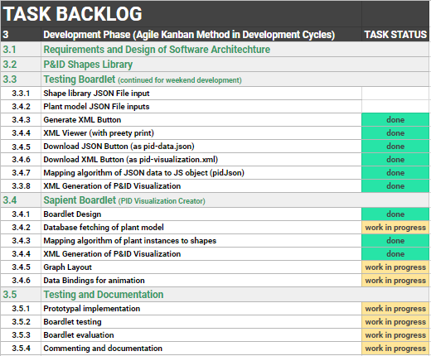
Task Backlog – Overview Overview of tasks: Week 11

Slide 3
Task Backlog – Overview Overview of tasks: Week 10

Slide 4
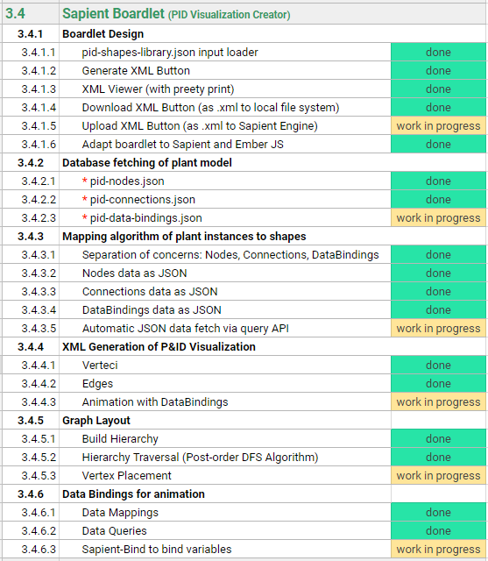
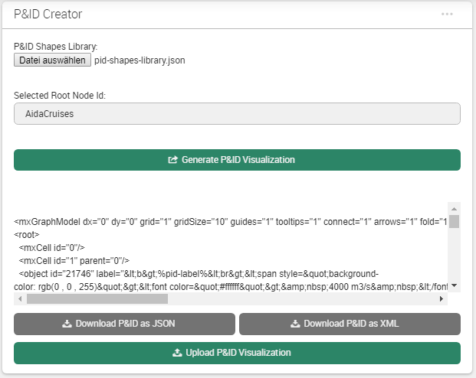
Sapient Boardlet Weekly Sprint 10

Slide 5
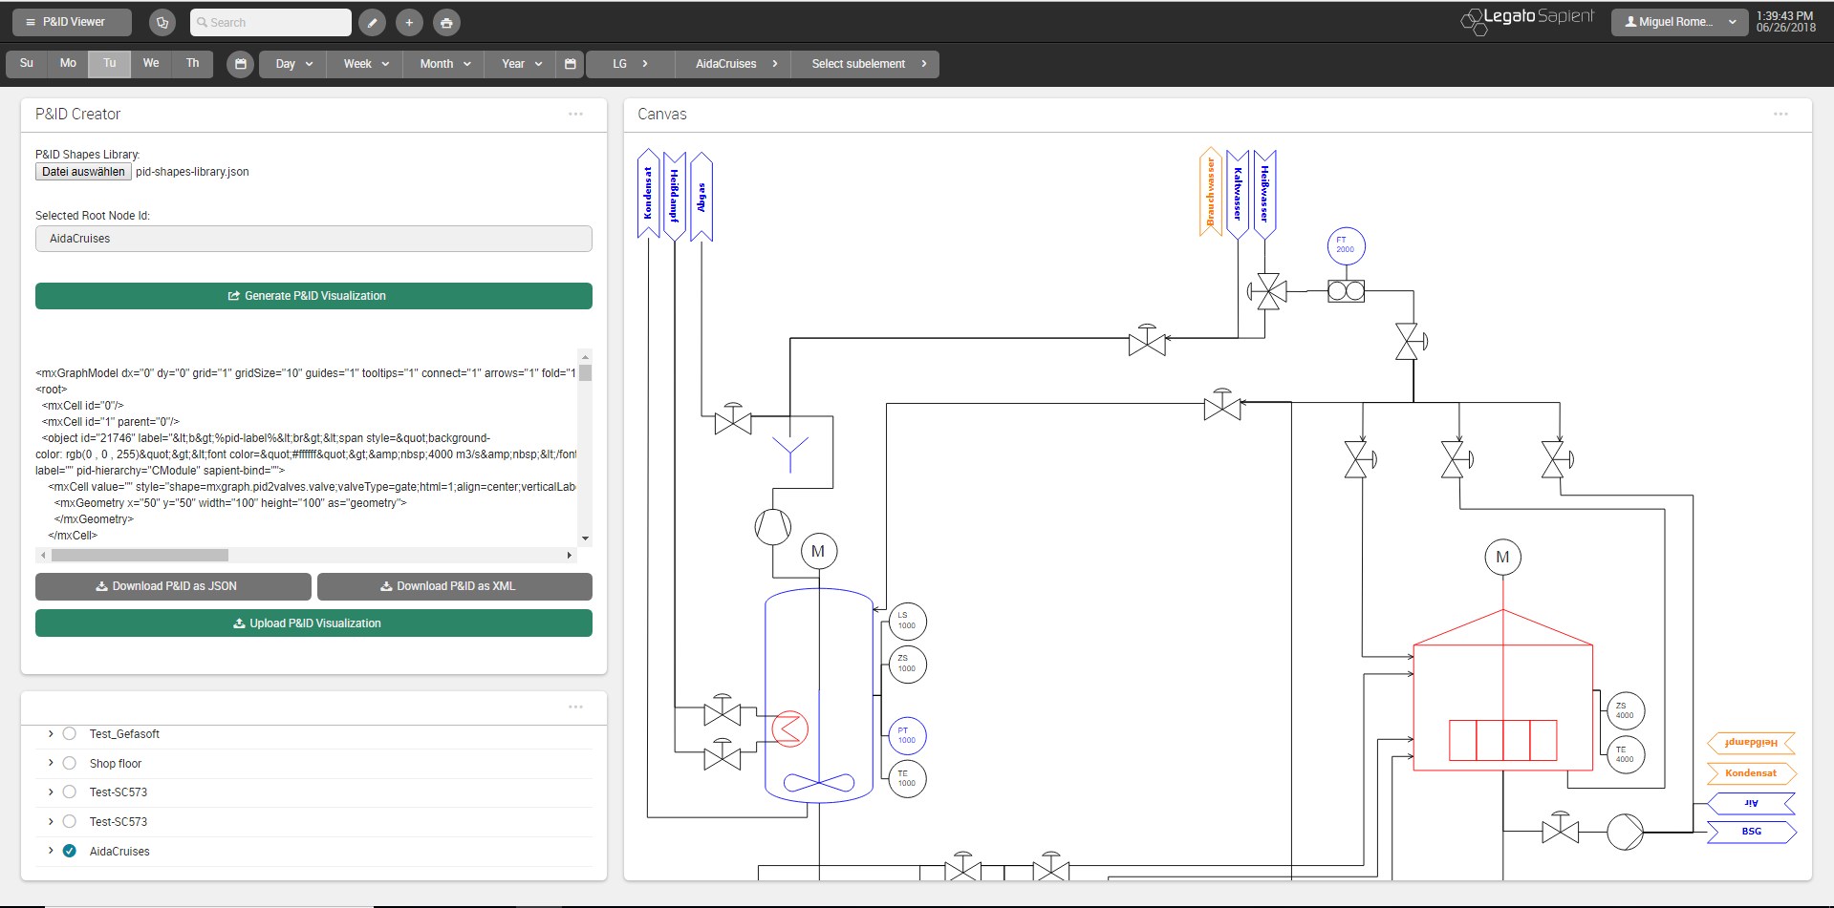
P&ID Viewer - Dashboard

Slide 6
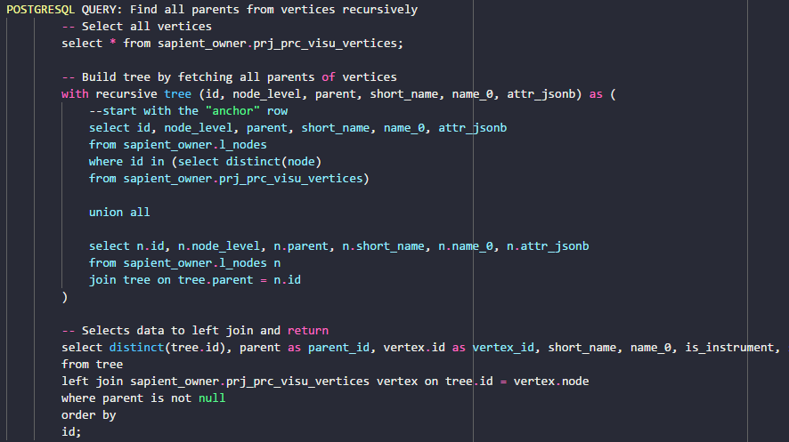
SQL Queries Weekly Sprint 10
Complex SQL Query with LEFT JOIN
l_nodes
Wanted Query Data
visu_vertices
LEFT JOIN ON tree.id = vertex.node

Slide 7
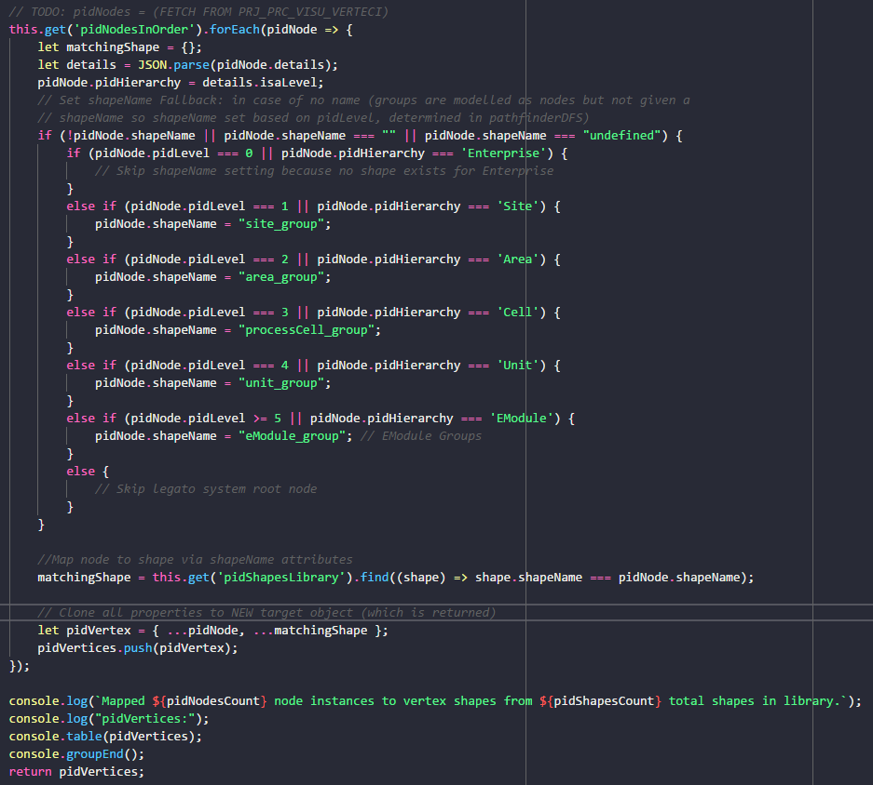
mapNodesToShapes() Weekly Sprint 10

Slide 8
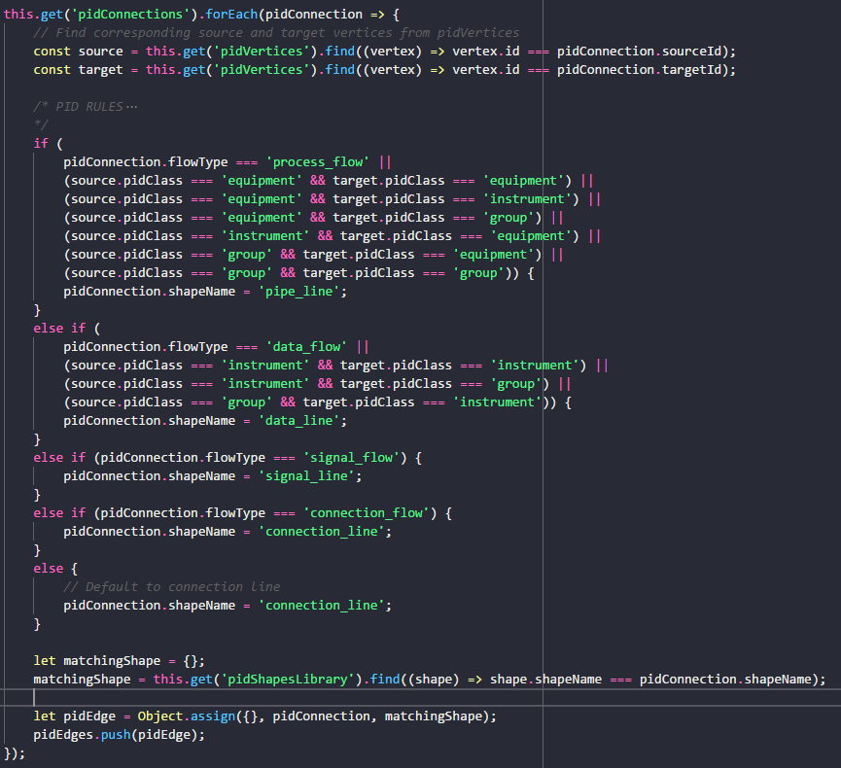
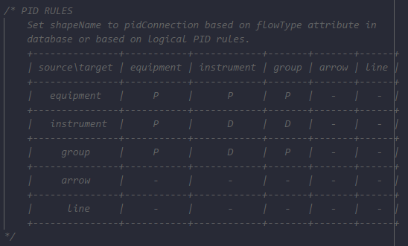
mapConnectionsToShapes()
P&ID Rules to determine shapeName according to pidClass of source and target shapes of connection.
Rules as Adjacency Matrix:

Slide 9
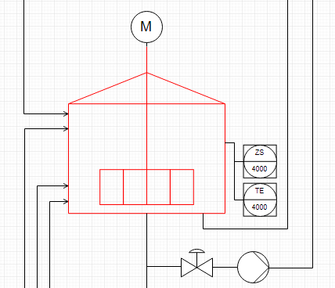
vertexPlacement() Concept
DFS Pathfinder traversal returns traversal path (ordered array of vertices)
Count units to construct general grid layout.
Implement Units and CModules as groups (containers) with mxGraph API.
Vertex placement inside group: square grid algorithm places nodes inside
Rules for example: if (valve to instrument) : instrument above valve
pidLevel to isaLevel map:
1 : Enterprise
2 : Site
3 : Area
4 : Process Cell
5 : Unit
6 : Emodule
…
n : Cmodule
(only last level labelled as Cmodule)
Enterprise : AIDA Cruises
…
Site : AIDA
…
Area : Brewery
…
Process Cell : Brewhouse
…
REMAKE WITH DRAW IO
Constructs grid layout as 2D-array
Units layed out inside each grid cell separately, units placed in grid at the end.
Unit : U_L2
13
U_M5
17
U_P3
…
…
EModule : Water_injection
6
Stem_ heating
12
14
15
16
…
…
…
…
…
…
…
…
…
…
…
Siblings (in level)
CModule :
1
2
3
4
5
7
8
9
10
…
…
…
…
…
…
Control_valve_440
Pump_P40
Motor
Kettle_sensor_Z
Kettle_sensor_T
11

Slide 10
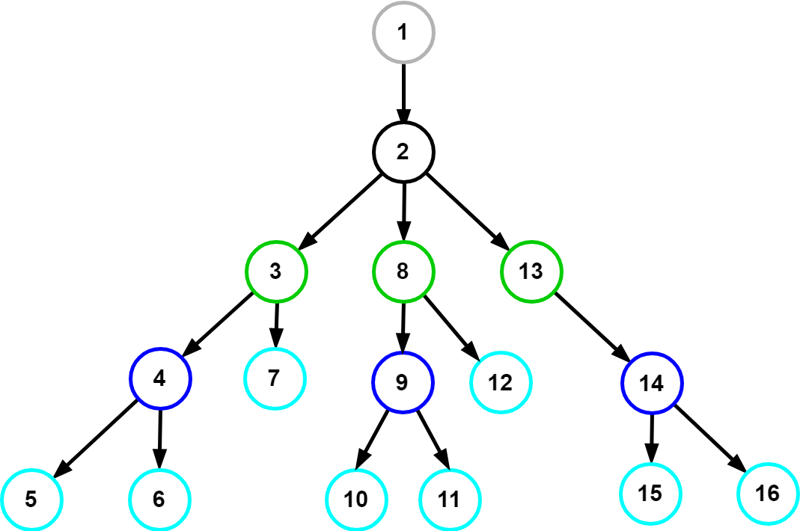
vertexPlacement() 1 – buildHierarchy()
flatArray
treeArray
buildHierarchy(flatArray)
Input
Output
Flat Array (hierarchical relations via parent attribute):
Tree Array (nested hierarchy via children attribute):
1 | 2 | 3 | 4 | 5 | 6 | 7 | 8 | 9 | 10 | 11 | 12 | 13 | 14 | 15 | 16
1 | 2 | 3 | 4 | 5 | 6 | 7 | 8 | 9 | 10 | 11 | 12 | 13 | 14 | 15 | 16

Slide 11
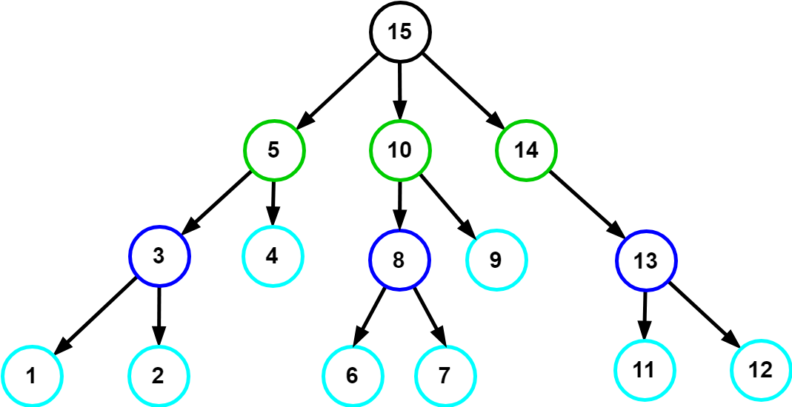
vertexPlacement() 2 – traverseAndSort()
nodeTree
path
(for vertex placement)
traverseAndSort(nodeTree)
Input
Output
Tree Array (nested hierarchy):
Path Array:
1 | 2 | 3 | 4 | 5 | 6 | 7 | 8 | 9 | 10 | 11 | 12 | 13 | 14 | 15 | 16
1 | 2 | 3 | 4 | 5 | 6 | 7 | 8 | 9 | 10 | 11 | 12 | 13 | 14 | 15 | 16

Slide 12
vertexPlacement() 3 – placeVertices()
nodeTree
path
(for vertex placement)
placeVertices(path)
Input
Output
Tree Array (nested hierarchy):
Path Array:
1 | 2 | 3 | 4 | 5 | 6 | 7 | 8 | 9 | 10 | 11 | 12 | 13 | 14 | 15 | 16
1 | 2 | 3 | 4 | 5 | 6 | 7 | 8 | 9 | 10 | 11 | 12 | 13 | 14 | 15 | 16

Slide 13
vertexPlacement() Family Tree Analogy - Terminology
Path Array:
1 | 2 | 3 | 4 | 5 | 6 | 7 | 8 | 9 | …
Siblings Array:
1 | 6 | 7 | 12 | 13 | 14 | 15 | …
Families Arrays:
1 | 2 | 3 | 4 | 5 | 6 | 7 | 8 | 9 | …
7 | 8 | 9 | 10
 |  |  |  | ?

Slide 14
vertexPlacement() Algorithm Overview
forEach vertex in pidVertices:
if (not group):
calculate cell area
store cell area
position current vertex:
get previous vertex position (x, y values)
apply positioning rules
set current vertex position
update value of previous x, y values
else if (group):
sum areas of contained cells

Slide 15
Next Sprint – ToDos Weekly Sprint 10
Boardlet Design
Fix floating buttons (side-by-side)
Design of root-node-selection input field
Fix query of siblings when selecting one root node
Build Hierarchy Function
Fix to start from selected root node (to work out for multiple)
Database queries
Connect remaining tables to repository with LC2 (instructions in daily-routine notes)
getData() generic Function
pidRootNode name query (to display in input field on updateInput())
pidNodes query
pidConnections query
Process Variables query
Animations via sapient-bind
Documentation and Commenting
Modularization of code
JsDocs
Testing

Slide 16
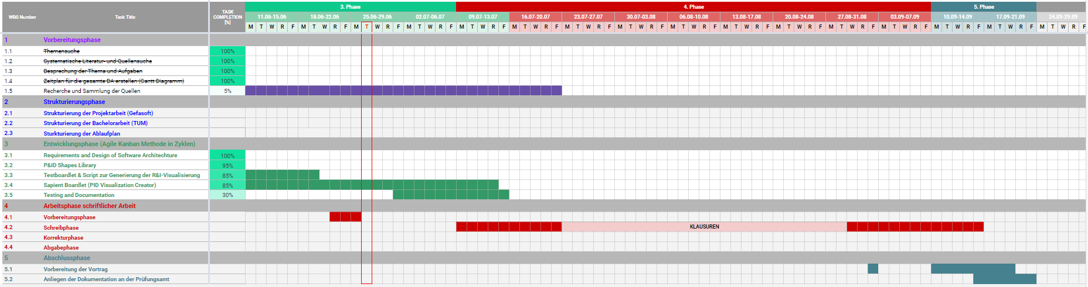
Project – Overview Overview of tasks: Week 10

